Slide 1
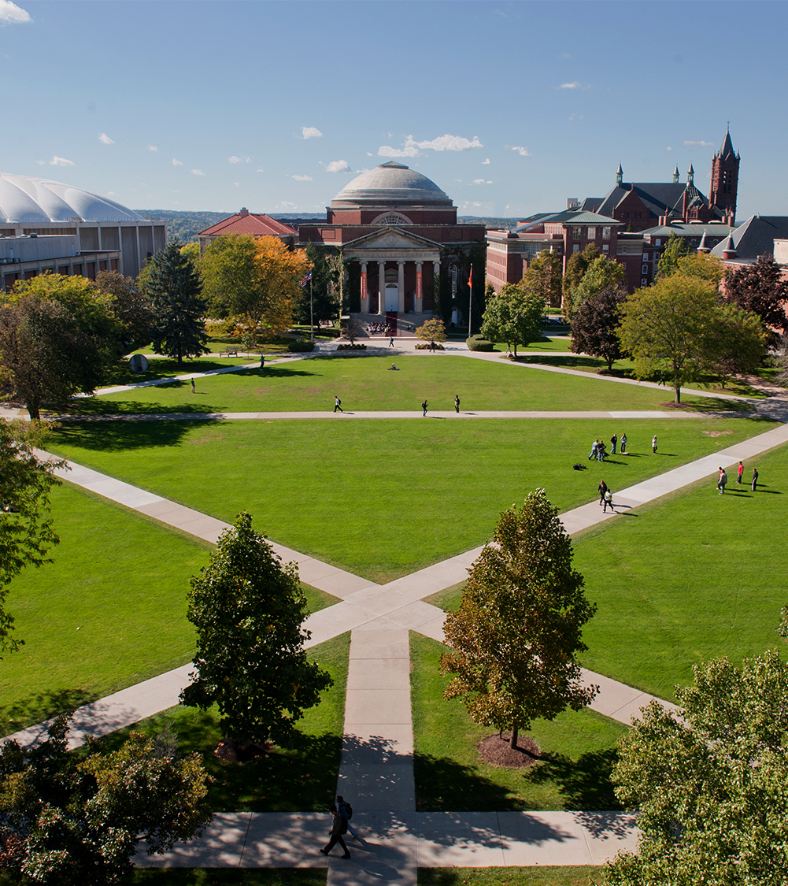
Development of a Specialized Facial Recognition Technique for Individuals Wearing COVID-19 Facial PPE
Department of Electrical Engineering and Computer Science
Alison Davis & Ricardo Alonzo Ugalde
March 3rd 2021

Slide 2
Facial Recognition (FR) in Masks
COVID-19 impacts on biometrics
Masks reduce data available for FR
Increased demand for contactless recognition
Improve upon existing algorithm
Eigenfaces algorithm
Evaluate impacts of masks on FR performance
Modifications improved accuracy of masked recognition by 10%
Continuation of work
Increase amount of data studied
Increase variation in images
Department of Electrical Engineering and Computer Science

Slide 3
Background & Previous Works
General FR
Survey of existing algorithms
Holistic vs local feature recognition
FR accuracy varies with race
FR in Masks
NIST survey of 89 commercial algorithms
Unanimous degradation of performance in masks
5% - 50% error rates
Facial occlusion problem
Reconstruction vs omission
Department of Electrical Engineering and Computer Science

Slide 4


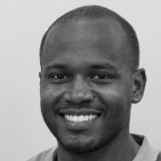
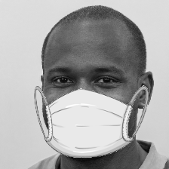
Experimental Design
Assumptions
Constant lighting
Frontal pose
Black and white images
Sources of Data
Mask digitally inserted onto images
Source Code Modifications
Added capability for recognition batches
Experiment C modifications
Department of Electrical Engineering and Computer Science

Slide 5
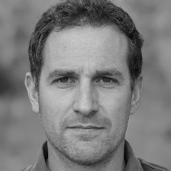
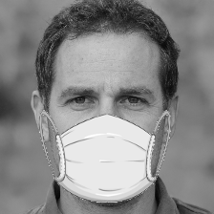

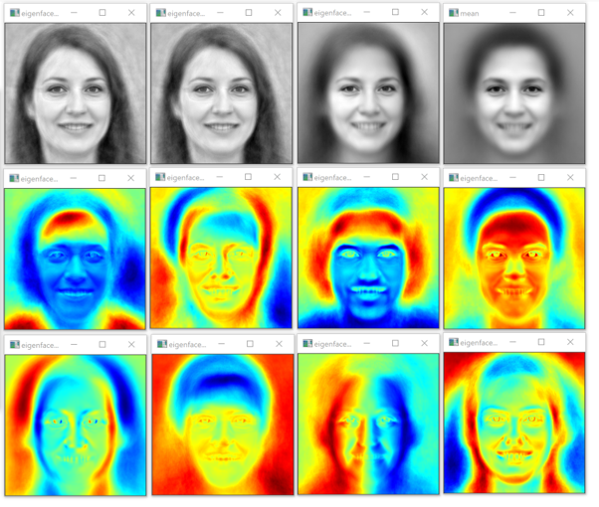
Experiment A Design
Unmasked Training, Masked Recognition
Currently most common occurrence
Trained on 500 masked faces
Tested 1000 unmasked faces
500 known, 500 unknown
Evaluated results over a series of distance thresholds
Department of Electrical Engineering and Computer Science

Slide 6
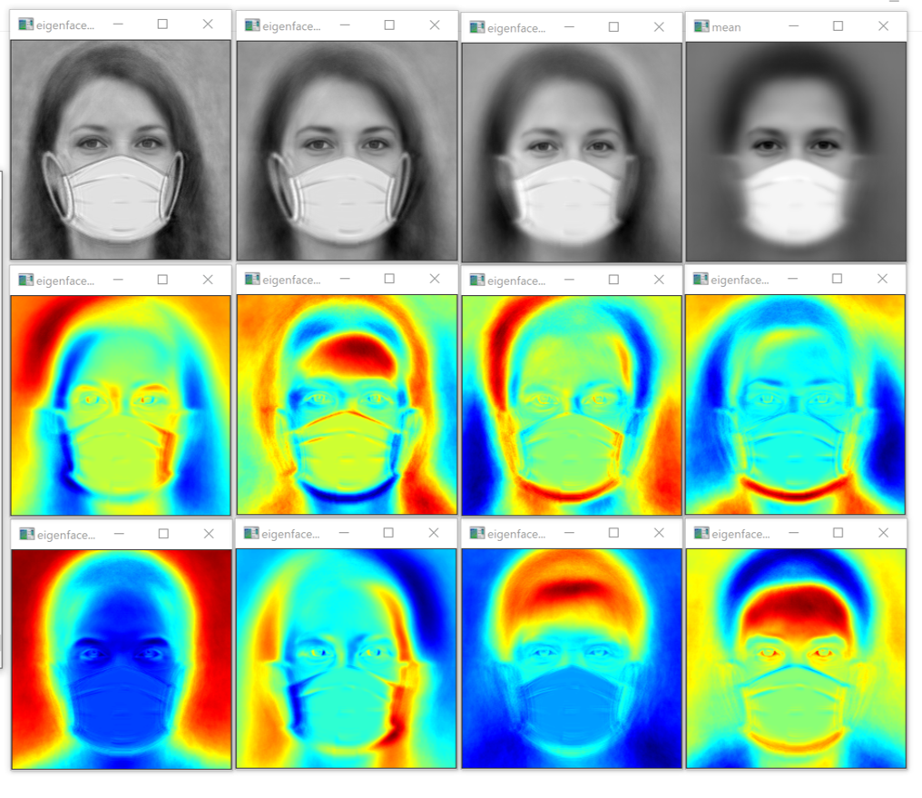
Experiment B Design
Masked Training, Unmasked Recognition
Trained on 500 unmasked faces
Tested 1000 masked faces
500 known, 500 unknown
Evaluate over a series of distance thresholds
Department of Electrical Engineering and Computer Science

Slide 7
Experiment C Design
Evaluation of eigenfaces algorithm with modifications
Analyzed results of Experiments A & B
Created modifications accordingly
Repeated Experiment A Design with modified code
Department of Electrical Engineering and Computer Science

Slide 8
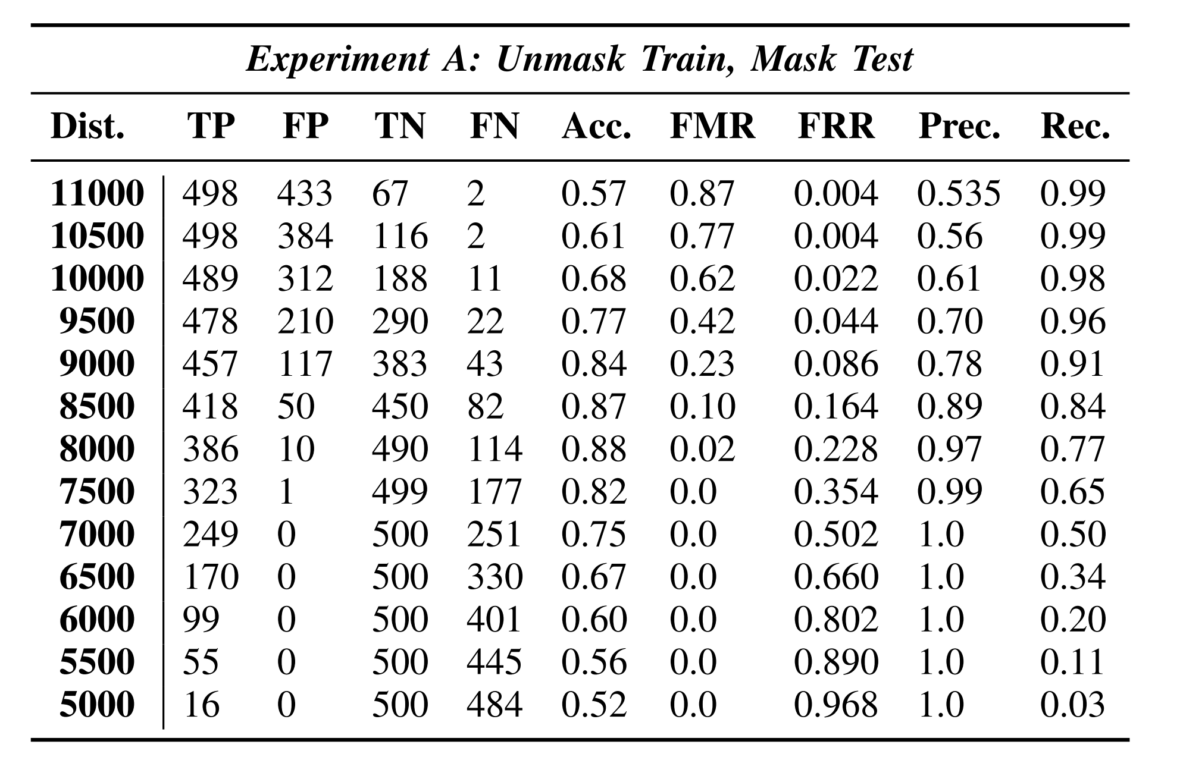
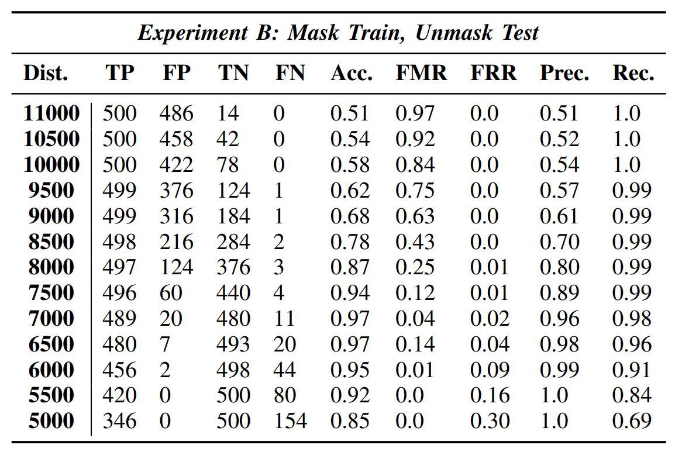

Results of Experiments A & B
Identifying thresholds for maximum performance
Department of Electrical Engineering and Computer Science

Slide 9
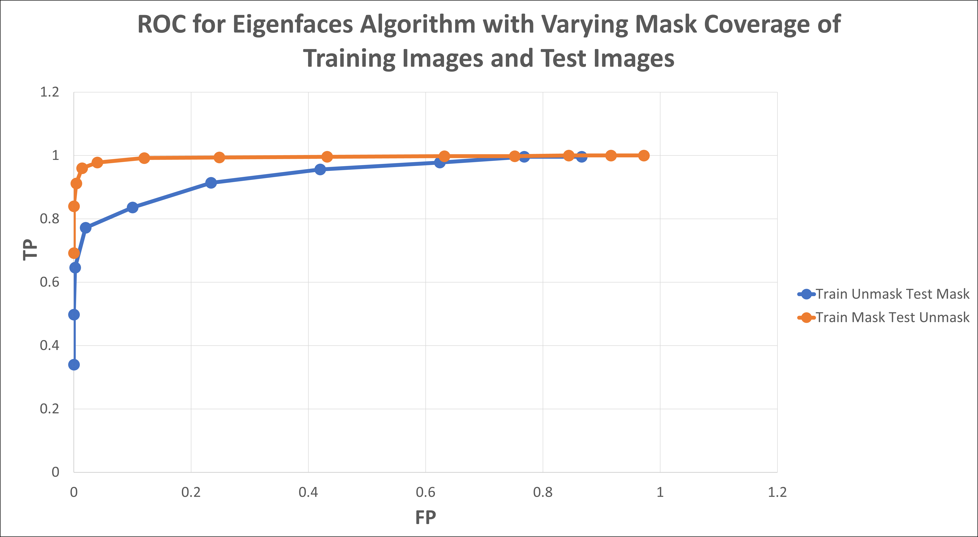
ROC Curves from Experiments A & B
Identifying better performance using ROC curves
Department of Electrical Engineering and Computer Science

Slide 10
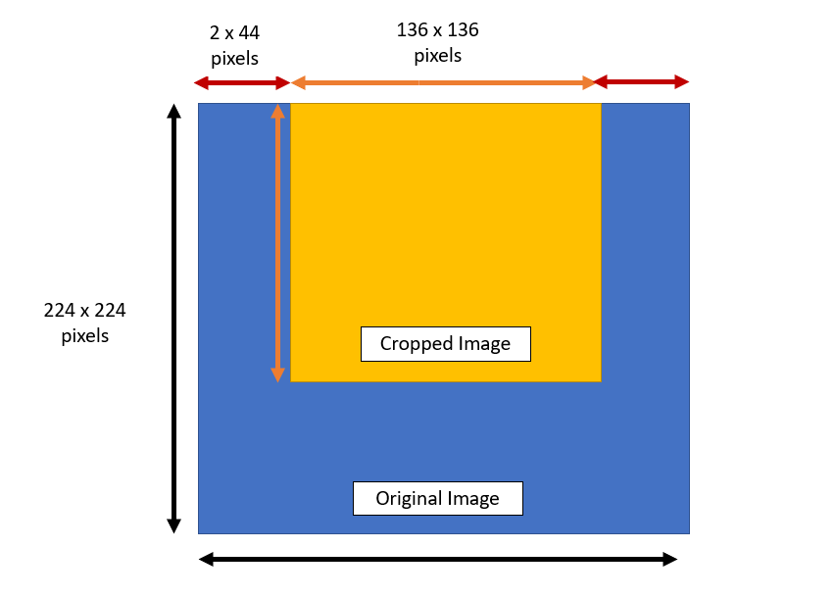
Tailoring Experiment C
Design of Experiment C was based on Experiments A & B results
A ~9% less accurate than B
Training with excess information decreased performance
Occlusion: technique of omission
Department of Electrical Engineering and Computer Science

Slide 11
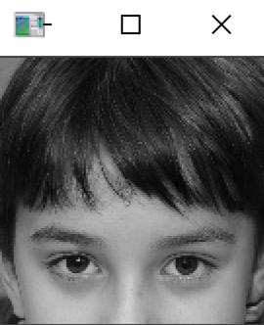
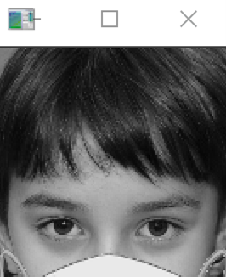
Experiment C Design
Unmasked Training, Masked Recognition with cropping model
Modified code to train on both cropped and non-cropped faces
Trained and tested identical data to Experiment A
Evaluated results over a series of distance thresholds with flag set for masked recognition
Training
Testing
Department of Electrical Engineering and Computer Science

Slide 12
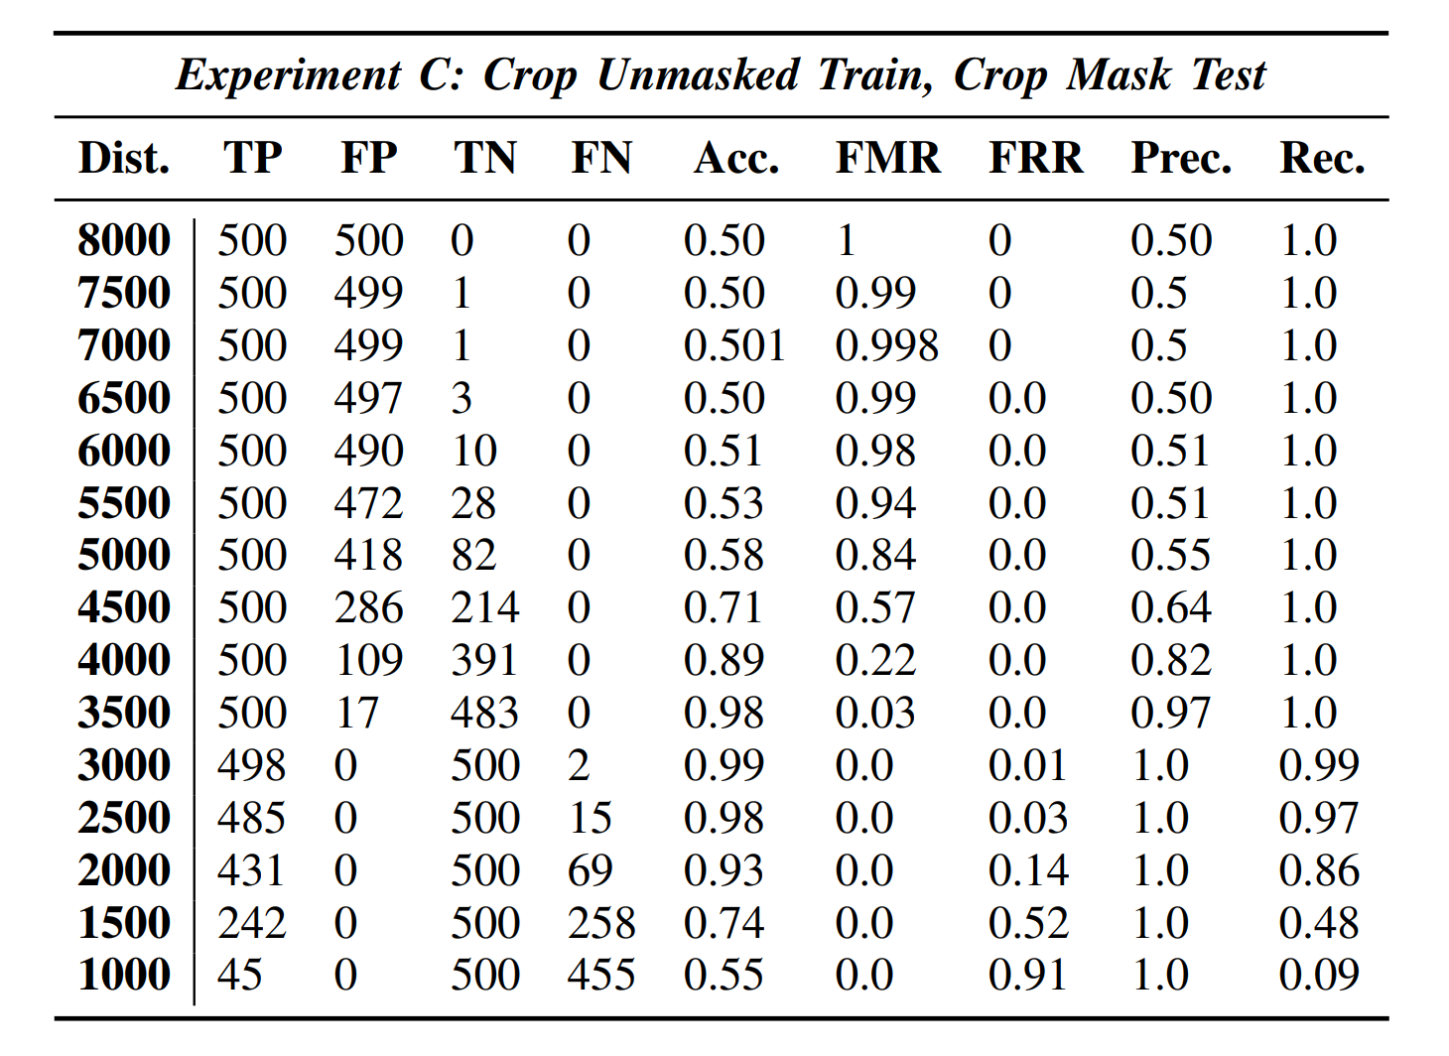
Experiment C Results
Evaluation of eigenfaces algorithm with modifications
Department of Electrical Engineering and Computer Science

Slide 13
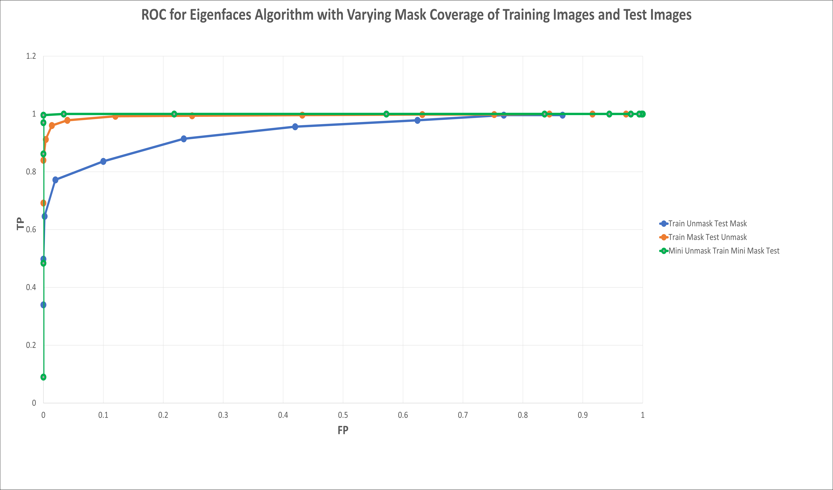
ROC Curves from Experiments A & B
Identifying better performance using ROC curves
Department of Electrical Engineering and Computer Science

Slide 14
Conclusion/Future Work
Results
Experiment B outperformed Experiment A by ~9% accuracy
Eigenfaces performs better training without excess data
Training with a cropped model for masked identification increased eigenfaces performance by >10% accuracy for the given test data
Thus, training with omission of the parts of the face that are known will be occluded in masks could increase FR performance
Future Work
Testing with greater variety of data
Increase robustness of testing to include lighting, pose, mask color, etc.
Department of Electrical Engineering and Computer Science

